Slide 1

Computer Organization & Assembly Language(CS-215T)
Lecture by:
Mr. Shakir Karim
Assistant Professor
DoCS&IT, SSUET
Batch 2022F

Slide 2
Topic
Performance Issues and Improvement Techniques
Computer Science & Information Technology Department
Sir Syed University of Engg. & Tech.
Lecture by: Mr. Shakir Karim

Slide 3
Trends in Technology
We concluded that
A computer consists of
Gates,
Memory Cells,
Interconnections among these elements
The gates and memory cells are constructed of simple electronic components, such as transistors and capacitors.
The integrated circuit exploits the fact that
such components as transistors, resistors, and conductors can be fabricated from a semiconductor such as silicon.
Many transistors can be produced at the same time on a single wafer of silicon
Computer Science & Information Technology Department
Sir Syed University of Engg. & Tech.
Lecture by: Mr. Shakir Karim

Slide 4
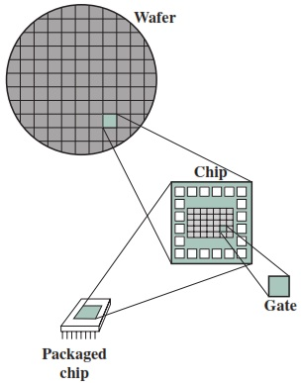
Trends in Technology
Earlier, few gates and memory cells could be reliably manufactured and packed together – SSI
As time went on, it became possible to
Pack more and more components
on the same chip …
Hence the terms
LSI
VLSI
ULSI
Computer Science & Information Technology Department
Sir Syed University of Engg. & Tech.
Lecture by: Mr. Shakir Karim

Slide 5
Trends in Technology
Moore observed that
the number of transistors that could be put on a single chip was doubling every year
the pace continued year after year and decade after decade.
The pace slowed to a doubling every 18 months in the 1970s but has sustained that rate ever since.
The famous Moore’s law, propounded by Gordon Moore, cofounder of Intel, in 1965
Computer Science Department
Sir Syed University of Engg. & Tech.
Lecture by: Mr. Shakir Karim

Slide 6
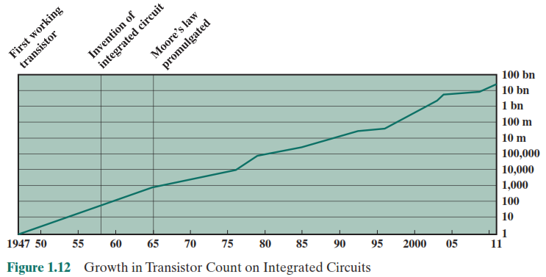
Trends in Technology
The consequences of Moore’s law are profound:
1. The cost of a chip has remained virtually unchanged during this period of rapid growth in density. This means that the cost of computer logic and memory circuitry has fallen at a dramatic rate.
Computer Science Department
Sir Syed University of Engg. & Tech.
Lecture by: Mr. Shakir Karim

Slide 7
Trends in Technology
2. Because logic and memory elements are placed closer together on more densely packed chips, the electrical path length is shortened, increasing operating speed.
3. The computer becomes smaller, making it more convenient to place in a variety of environments.
4. There is a reduction in power requirements.
5. The interconnections on the integrated circuit are much more reliable than solder connections. With more circuitry on each chip, there are fewer inter-chip Connections.
Computer Science & Information Technology Department
Sir Syed University of Engg. & Tech.
Lecture by: Mr. Shakir Karim

Slide 8
Trends in Technology
The concept of family of compatible computers
Characteristics of family includes:
Similar / Identical Instruction Set
Similar / Identical Operating Systems
Increasing Speed
Increasing Number of IO Ports
Increasing Memory Size
Increasing Cost
Computer Science Department
Sir Syed University of Engg. & Tech.
Lecture by: Mr. Shakir Karim

Slide 9
Microprocessor–the Speed Monster
Remember the ENIAC on a single chip!
Power of microprocessors seem virtually free
Providing the power requirements of desktop applications
Videoconferencing
Speech recognition
Image processing
Simulation modeling
3-D rendering
Multimedia authoring
Voice and video annotation of files
Computer Science Department
Sir Syed University of Engg. & Tech.
Lecture by: Mr. Shakir Karim

Slide 10
Isn’t it fascinating!
Same building blocks as 50 years before
BUT
Sophisticated technology for better performance
Then Why the speed monster?
Computer Science & Information Technology Department
Sir Syed University of Engg. & Tech.
Lecture by: Mr. Shakir Karim

Slide 11
Why The Speed Monster?
Evolution continues at a fast rate
Reducing the distances between circuits
Leading to improved performance 4-to-5 folds every three years
However,
the other side of the coin is different
Seems cooking food on the candle flame!
Computer Science & Information Technology Department
Sir Syed University of Engg. & Tech.
Lecture by: Mr. Shakir Karim

Slide 12
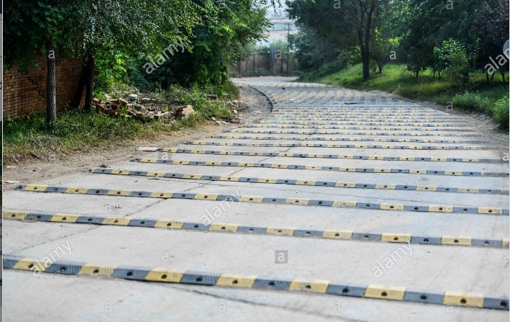

Performance Imbalance
Track for McLaren?
Computer Science & Information Technology Department
Sir Syed University of Engg. & Tech.
Lecture by: Mr. Shakir Karim

Slide 13
Techniques To Feed The Monster
Pipelining
Branch Prediction
Superscalar Execution
Data Flow Analysis
Speculative Execution
Necessary to execute
many instructions per processor cycle
rather than
to take many cycles per instruction.
Computer Science & Information Technology Department
Sir Syed University of Engg. & Tech.
Lecture by: Mr. Shakir Karim

Slide 14
Balancing the Imbalance
Retrieving more bits at one time
by making DRAMs “wider” rather than “deeper”
by using wide bus data paths
Making the DRAM interface more efficient
by including a cache on the DRAM chip
Reduce the frequency of memory access
by incorporating efficient cache structures between the processor and main memory
Increase the interconnect bandwidth between processors and memory
by using higher-speed buses and a hierarchy of buses to buffer and structure data flow
Computer Science & Information Technology Department
Sir Syed University of Engg. & Tech.
Lecture by: Mr. Shakir Karim

Slide 15
Improvement In Chip Organization & Architecture
Increase in Hardware speed of processor
Increase the size & speed of caches
Reduce the frequency of memory access
Use Parallelism
Computer Science & Information Technology Department
Sir Syed University of Engg. & Tech.
Lecture by: Mr. Shakir Karim

Slide 16
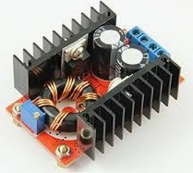
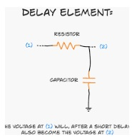

Obstacles In Improvement
Traditional dominant factors to performance gains are to increase
Clock Speed & Logic Density
However, this comes with number of obstacles
Power
RC Delay
Memory Latency & Throughput
Computer Science & Information Technology Department
Sir Syed University of Engg. & Tech.
Lecture by: Mr. Shakir Karim

Slide 17
Trends in Power & Energy in ICs
Power is the biggest challenge at present.
Q how should a system architect think about performance, power, and energy?
A three primary concerns
1 - What is the maximum power a processor ever requires?
More power => more current => more voltage drop => device malfunction
Modern processors incorporate voltage indexing and regulate voltage as needed which will decrease performance.
Computer Science & Information Technology Department
Sir Syed University of Engg. & Tech.
Lecture by: Mr. Shakir Karim

Slide 18
Trends in Power & Energy in ICs
2- What is the sustained power consumption?
This metric is called Thermal Design Power (TDP)
determines the cooling requirement.
manages heat by reducing clock rate
Thereby,
reduces power
and in worse case
activate the thermal overload trip to power down the chip.
Computer Science & Information Technology Department
Sir Syed University of Engg. & Tech.
Lecture by: Mr. Shakir Karim

Slide 19
Trends in Power & Energy in ICs
3- Which metric should be used to compare processors – energy or power?
Energy is better metric
Why?
Since, it is tied to a specific task and
the time required to complete that task.
The energy to execute a workload
= Power_{Avg} X the execution time for the workload
Energy consumption should be used for comparison instead of the power consumption.
Computer Science & Information Technology Department
Sir Syed University of Engg. & Tech.
Lecture by: Mr. Shakir Karim

Slide 20
Trends in Power & Energy in ICs
Example
Processor A may have a 20% higher average power consumption than processor B, but what happened if A executes the task in only 70% of the time needed by B?
The energy consumption of A will be
1.2 X 0.7 = 0.84
which is clearly better.
Computer Science & Information Technology Department
Sir Syed University of Engg. & Tech.
Lecture by: Mr. Shakir Karim

Slide 21
Dependability
Module Reliability:
Mean Time To Failure (MTTF) - reliability measure.
The reciprocal of MTTF is a rate of failures, generally reported as failure per billion hours of operation, or FIT (failure in time)
MTTF of 1,000,000 hours equals 10⁹/10⁶or 1000 FIT.
Computer Science & Information Technology Department
Sir Syed University of Engg. & Tech.
Lecture by: Mr. Shakir Karim

Slide 22
Dependability
Service interruption
measured as Mean Time To Repair (MTTR)
MTBF = MTTF + MTTR
(MTBF = mean time between failures)
What if a collection of modules has exponentially distributed lifetimes (i.e., the age of a module is not important in probability of failure)?
Then, the overall failure rate of the collection is the sum of the failure rates of the modules.
Computer Science & Information Technology Department
Sir Syed University of Engg. & Tech.
Lecture by: Mr. Shakir Karim

Slide 23
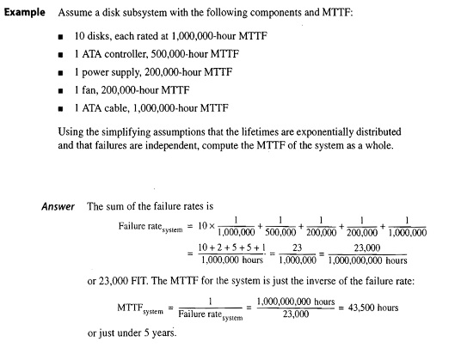
Dependability
Example – MTTF & FIT
Computer Science & Information Technology Department
Sir Syed University of Engg. & Tech.
Lecture by: Mr. Shakir Karim

Slide 24
Dependability
Module Availability
measure of the service accomplishment
w.r.t the alternation between the two states of
accomplishment and interruption.
For non-redundant systems with repair,
module availability = (MTTF) / (MTTF + MTTR)
Computer Science & Information Technology Department
Sir Syed University of Engg. & Tech.
Lecture by: Mr. Shakir Karim

Slide 25
Comparing Any Two Systems
When a computer is faster than another?
Response time – also referred to as Execution time
-time between start and completion of an event.
Throughput – also referred to as Bandwidth
-the total amount of work done in a given time.
X is faster than Y => X is n times faster than Y
n = Execution-Time_{Y} / Execution-Time_{X}
n = Performance_{X} / Performance_{Y}
Computer Science & Information Technology Department
Sir Syed University of Engg. & Tech.
Lecture by: Mr. Shakir Karim

Slide 26
Comparing Any Two Systems
Bandwidth has outpaced latency
A simple rule of thumb:
bandwidth grows by at least the square of the improvement in latency.
Wire delay
scales poorly compared to transistor performance
has become a major design limitation for large ICs
often more critical than transistor switching delay
Scalability – being able to expand memory, the number of processors, and disks
Computer Science & Information Technology Department
Sir Syed University of Engg. & Tech.
Lecture by: Mr. Shakir Karim

Slide 27
Quantitative Principles of Design
Parallelism
Parallelism at the system level – Spreading workload of handling requests among the processors and disk.
Parallelism at the data level – spreading of data across many disks for parallel reads and writes
Parallelism at the individual level – parallelism among instructions through pipelining.
Parallelism at digital design level –
carry-lookahead (used by ALU to speed up the process of computing sum)
set-associative caches (multiple banks of memory typically searched in parallel)
Computer Science & Information Technology Department
Sir Syed University of Engg. & Tech.
Lecture by: Mr. Shakir Karim

Slide 28
Quantitative Principles of Design
Principal of Locality
Programs tend to reuse data and instructions they have used recently.
Rule of thumb:
a program spends 90% of its execution time in only 10% of the code.
Two types of locality:
Temporal Locality: recently accessed items are likely to be accessed in the near future.
Spatial Locality: items whose addresses are near one another tend to be referenced close together in time.
Computer Science & Information Technology Department
Sir Syed University of Engg. & Tech.
Lecture by: Mr. Shakir Karim

Slide 29
Quantitative Principles of Design
Focus on the common cases:
In making a design trade-off,
favor the frequent case over the infrequent case.
This principle applies when determining
how to spend resources,
since the impact of the improvement is higher
if the occurrence is frequent.
Computer Science & Information Technology Department
Sir Syed University of Engg. & Tech.
Lecture by: Mr. Shakir Karim

Slide 30
Laws Governing Parallelism
In applying the simple principle of common cases,
a million dollar question is
what the frequent case is and
how much performance can be improved
by making that case faster?
Two fundamental laws can be helpful
Amdahl’s Law
and
Little’s Law
Computer Science & Information Technology Department
Sir Syed University of Engg. & Tech.
Lecture by: Mr. Shakir Karim

Slide 31
Amdahl’s Law
proposed by Gene Amdahl in 1967
Statement:
"the performance improvement to be gained
from using some faster mode of execution
is limited by the fraction of the time
the faster mode can be used”.
Deals with the potential speedup of a program using
multiple processors compared to a single processor
Computer Science & Information Technology Department
Sir Syed University of Engg. & Tech.
Lecture by: Mr. Shakir Karim

Slide 32
Amdahl’s Law
What is speedup?
Speedup is the ratio that tells
how much faster a task will run using the computer with the enhancement as opposed to the original computer
Speedup =
Performance with enhancement
Performance without enhancement
Computer Science & Information Technology Department
Sir Syed University of Engg. & Tech.
Lecture by: Mr. Shakir Karim

Slide 33
Amdahl’s Law
Example:
Consider a program running on a single processor
such that a fraction (1 - f) of the execution time involves code that is inherently sequential,
and a fraction f that involves code that is infinitely parallelizable with no scheduling overhead.
Let T be the total execution time of the program using a single processor.
Then what will be the speedup using a parallel
processor with N Processors that fully exploits the
parallel portion of the program?
Computer Science & Information Technology Department
Sir Syed University of Engg. & Tech.
Lecture by: Mr. Shakir Karim

Slide 34

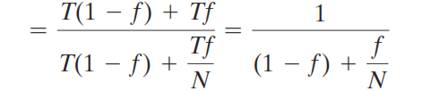
Amdahl’s Law
The speedup using a parallel processor with N Processors that fully exploits the parallel portion of the program will be:
Two conclusions:
1- What if f is small ?
2- What if N → ∞ ?
Computer Science & Information Technology Department
Sir Syed University of Engg. & Tech.
Lecture by: Mr. Shakir Karim

Slide 35
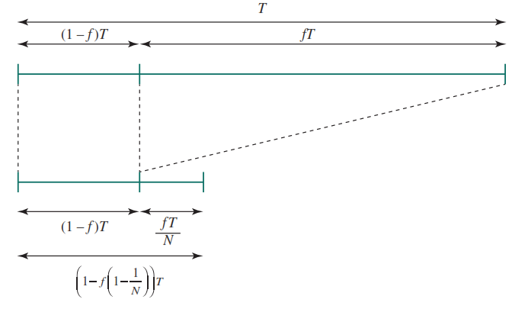
Illustration of Amdahl’s Law
Computer Science & Information Technology Department
Sir Syed University of Engg. & Tech.
Lecture by: Mr. Shakir Karim

Slide 36
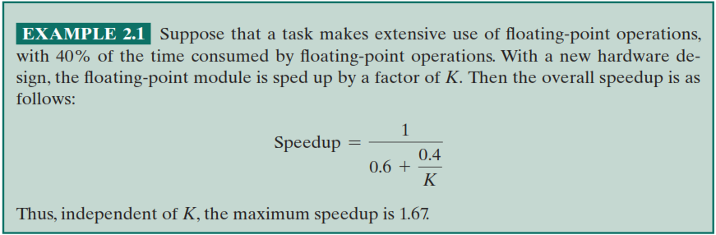
Example of Amdahl’s Law
Computer Science & Information Technology Department
Sir Syed University of Engg. & Tech.
Lecture by: Mr. Shakir Karim

Slide 37
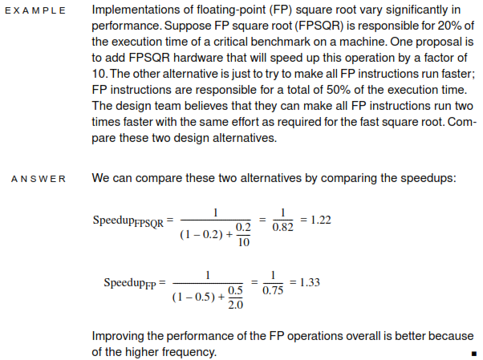
Example of Amdahl’s Law
Computer Science & Information Technology Department
Sir Syed University of Engg. & Tech.
Lecture by: Mr. Shakir Karim

Slide 38
Little’s Law
A fundamental and simple relation with broad applications is Little’s Law
Consider a steady state system to which
Items arrive at an average rate of λ items per unit time.
Items stay in the system an average of W units of time (i.e., average response time).
Finally, there is an average of L units in the system at any one time.
Little’s Law relates these three variables as
L = λ W
Computer Science & Information Technology Department
Sir Syed University of Engg. & Tech.
Lecture by: Mr. Shakir Karim

Slide 39
Little’s Law
Under steady state conditions,
the average number of items in a queuing system
equals
the average rate at which items arrive
multiplied by
The average time that an item spends in the system.
This relationship requires very few assumptions.
No need to know:
What the service time distribution is?
What the distribution of arrival times is?
Which order (or priority) items are served in?
Computer Science & Information Technology Department
Sir Syed University of Engg. & Tech.
Lecture by: Mr. Shakir Karim

